Slide 1

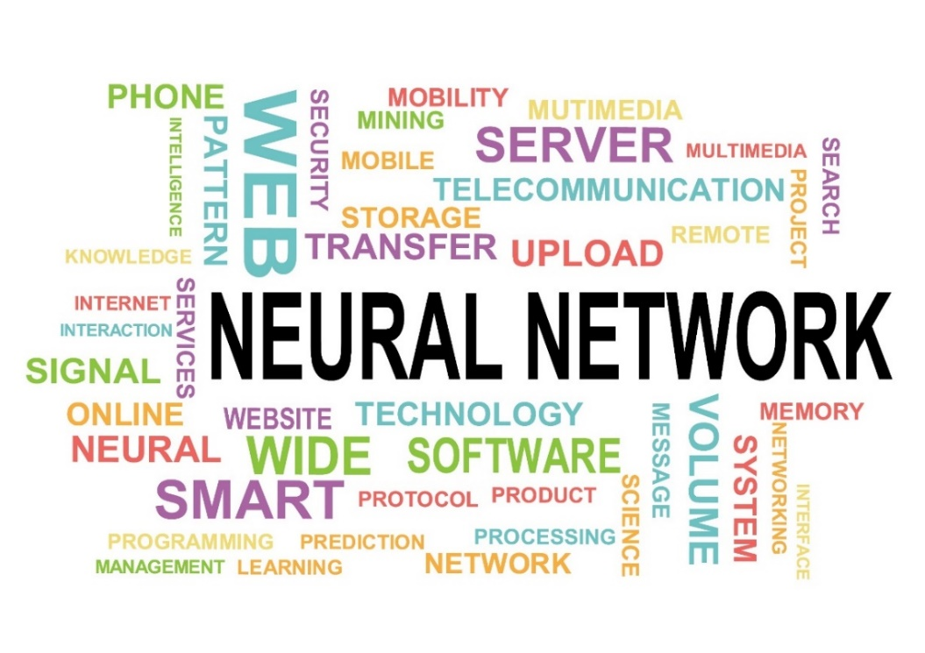
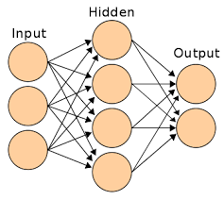


JA105 Part 1 Artificial Neural Networks & The Error Backpropagation Algorithm Academic Year 2022-23
Prof. John Abela
Department of CIS
john.abela@um.edu.mt
+ 365 79367936
Room 1A/27
FICT Building
©John Abela, 2018-2022
Faculty of
ICT
Department of
Computer Information Systems
Last Updated
21-Sep-2022

Slide 2


Core Topics
2
Neural
Networks
‘Core Topic’ modules are those that are used in more than one study unit. They may also be short revision or ‘transition’ topics.
JA101 – What is AI?
JA102 – Big Data Analytics
JA103 – Machine Learning - Principles & Concepts
JA104 – Mathematics Preliminaries for DS&A.
JA105 – Error Backpropagation Neural Networks I & II
JA106 – Statistics & Probability
JA107 – Cryptography
JA108 – Blockchain & Cryptocurrencies
JA109 – Deep Learning & CNNs
JA110 – Fourier Transforms
JA111 – Quantum Computing I & II
JA112 – Decision Trees and the ID3 Algorithm
JA113 – Eigenvalues and Eigenvectors
JA114 – Data Clustering
JA115 – Principle Component Analysis

Slide 3
JA105 – Backpropagation Neural Networks
3
Neural
Networks
This ‘Core Topic’ module is used in the following study units.
CIS2350 – Business Applications of AI.
CIS3087/3187 – Business Intelligence.
CIS5003 – Principles of Data Science.
CIS3400 – Introduction to Fintech (quick revision for coursework).

Slide 4
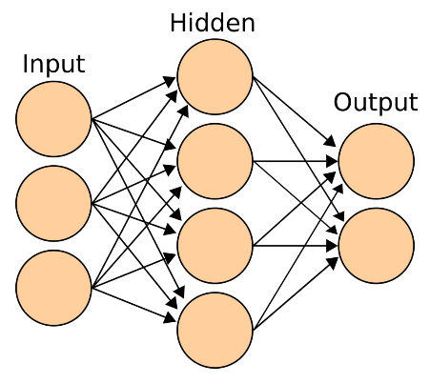
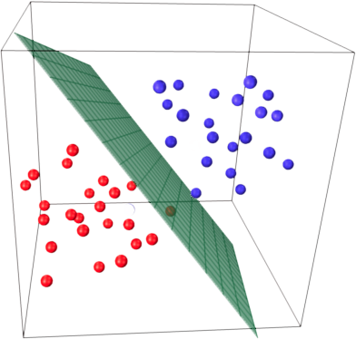
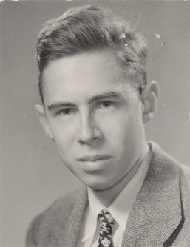

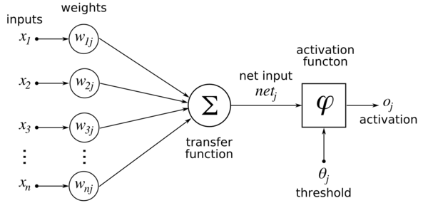
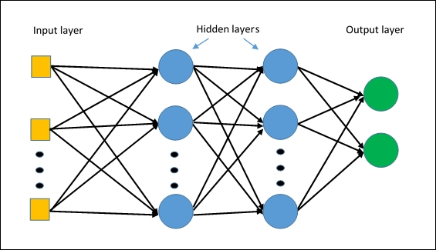
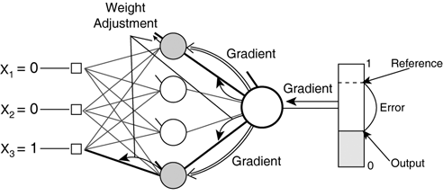
JA105 – Backpropagation Neural Networks
4
Neural
Networks
Part 1 (Slide Deck)
What is a Neural Network?
History and Development
Artificial Neurons
Linear Separability
Multi Layer Perceptrons
How an MLP Trains
Part 2 (Slide Deck)
The Error Back Propagation Algorithm.
How Error BackProp works.
Some notes about MLP Learning.

Slide 5
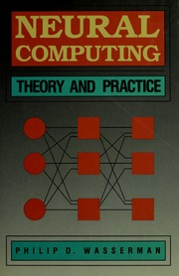
Pre-Requisites
5
Neural
Networks
Students as assumed to be familiar with basic matrix and vector arithmetic and differential calculus.
Familiarity with NP-Hard problems and their approximation is useful.
The main reference textbook is Neural Computing: Theory and Practice Hardcover – June 1, 1989, by Philip D. Wasserman (Author).

Slide 6

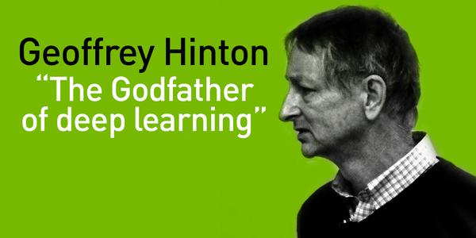
Topic Roadmap
6
Neural
Networks
Introduction & Motivation
Biological Brains
Artificial Neurons
The Perceptron
Linear Inseparability
Multi-Layer Perceptrons (MLPs)
MLP Training
Error Back Propagation
Summary and Comments
“The brain sure as hell does not work by somebody programming in rules”
Geoffrey Hinton

Slide 7

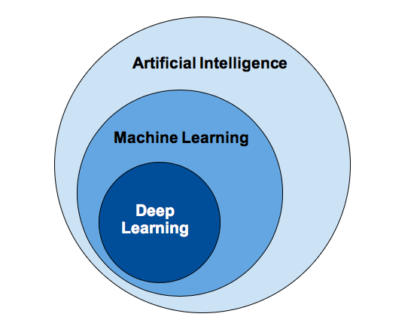
Preliminary Notes
7
Neural
Networks
The main objective of this module (slide deck) is to introduce the audience to the basic concepts and principles of Neural Networks.
The Multi-Layer Perceptron will be used to demonstrate how a neural network is trained.
This module is usually delivered at the beginning in order to give students time to start work on the coursework.
No prior knowledge of AI or Machine Learning is assumed except the material covered in JA101 – What is AI?

Slide 8
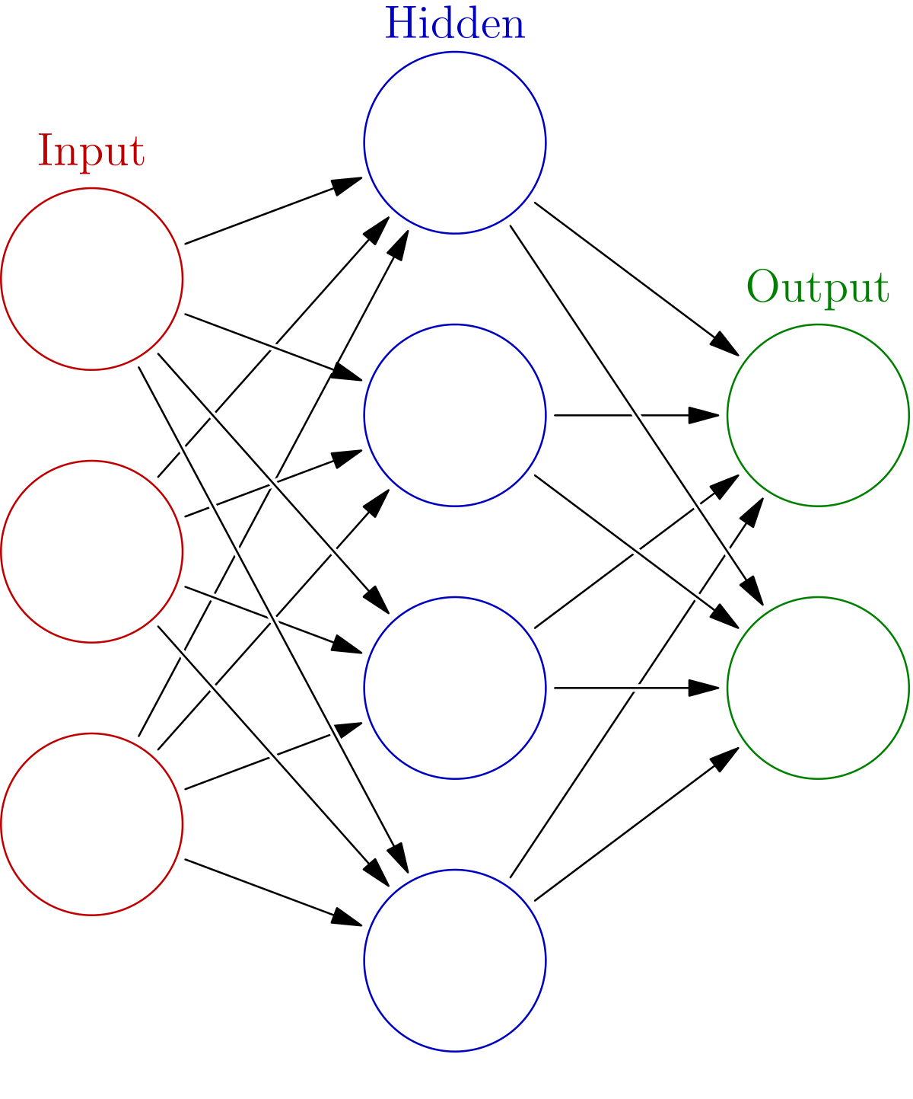
Introduction
8
Neural
Networks
What are Artificial Neural Networks?
Artificial Neural Networks (ANNs) are a (relatively) new method of ‘programming’ computers.
They do not need to be programmed using ‘code’. They automatically learn what to do from training examples.
They are exceptionally good at performing pattern recognition and other tasks that are very difficult to program using conventional techniques.
Programs that employ neural nets are also capable of learning on their own and adapting to changing conditions.
Their architecture, and computational model, are very loosely based on those of biological brains.

Slide 9
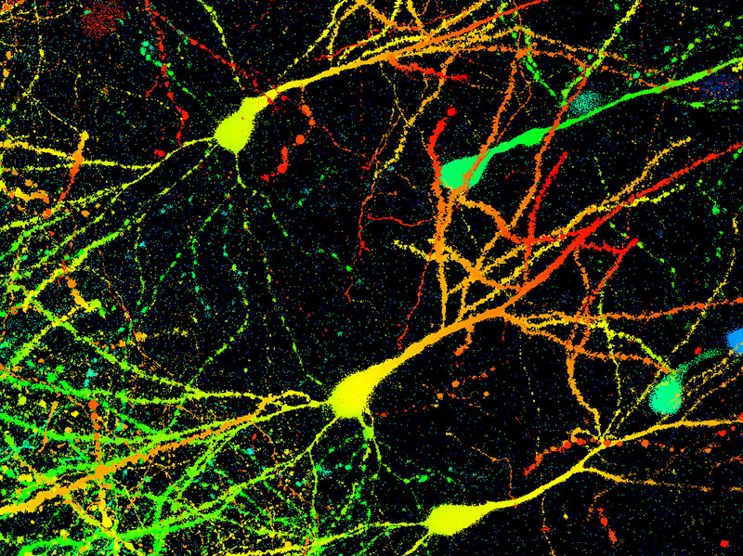

Background
9
Neural
Networks
An Artificial Neural Network (ANN) is an information processing paradigm that is inspired by the biological nervous systems, such as the human brain’s information processing mechanism.
The key element of this paradigm is the novel structure of the information processing system. It is composed of a large number of highly interconnected processing elements (neurons) working in unison to solve specific problems. ANNs, like people, learn by example.
An ANN is configured for a specific application, such as pattern recognition or data classification, through a learning process.
Learning in biological systems involves adjustments to the synaptic connections that exist between the brain’s neurons.
This is true of ANNs as well.

Slide 10
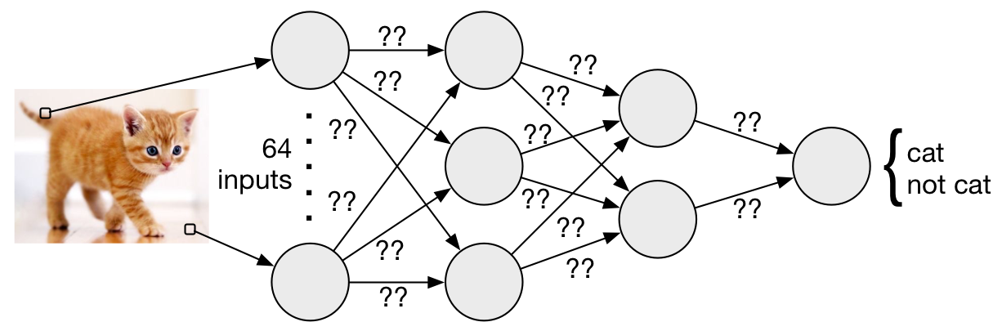
How are ANNs different?
10
Neural
Networks
Computers have to be explicitly programmed.
Analyze, and model, the problem to be solved.
Write the code in a programming language.
Neural Networks learn from examples.
No requirement of an explicit model (code) of the problem & no need for a programmer.
The neural network adapts itself during a training period, based on examples of similar problems even without a desired solution to each problem. After sufficient training the neural network is able to relate the problem data to the solutions, inputs to outputs, and it is then able to offer a viable solution to a brand new problem.
Able to generalize or to handle incomplete data.
Binary
Classifier

Slide 11
ANNs vs Conventional Algorithms
11
Neural
Networks
Digital Computers
Deductive Reasoning. We apply known, deterministic, rules to input data to produce output.
Computation is centralized, synchronous, and serial.
Memory is location addressable.
Not fault tolerant. One transistor goes and it no longer works.
Exact.
Applicable if well defined rules with precise input data.
Neural Networks
Inductive Reasoning. Given input and output data (training examples), we construct the rules.
Computation is collective, asynchronous, and parallel.
Memory is distributed, internalized, and short term.
Fault tolerant, redundancy, and sharing of responsibilities.
Inexact.
Applicable if rules are unknown or complicated, or if data are noisy or partial.

Slide 12
Some ANN Applications
12
Neural
Networks
classification
In marketing: consumer spending pattern classification
In defence: radar and sonar image classification
In agriculture & fishing: fruit and catch grading
In medicine: ultrasound and electrocardiogram image classification, EEGs, medical diagnosis
recognition and identification
In general computing and telecommunications: speech, vision and handwriting recognition
In finance: signature verification and bank note verification

Slide 13
Some ANN Applications
13
Neural
Networks
assessment
In engineering: product inspection, monitoring, and control.
In defence: target tracking.
In security: motion detection, surveillance image analysis and fingerprint matching.
forecasting and prediction
In finance: foreign exchange rate and stock market forecasting.
In agriculture: crop yield forecasting.
In marketing: sales forecasting.
In meteorology: weather prediction.

Slide 14
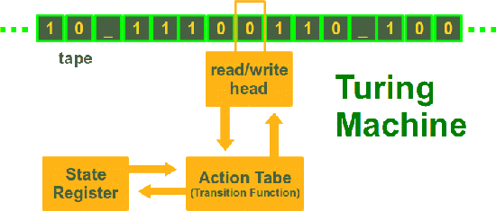
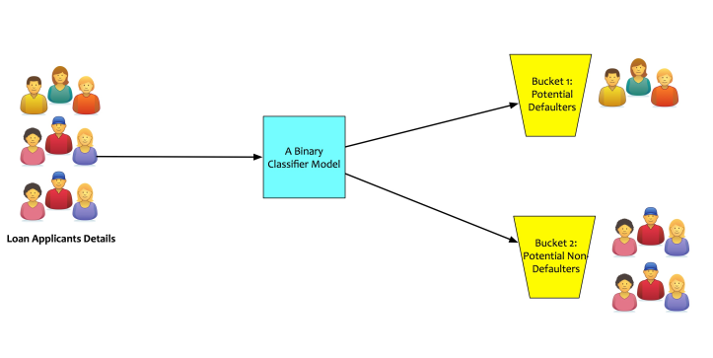
What ANNs Can and Cannot do
14
Neural
Networks
In principle, modern ANNs can compute any computable function, i.e., they are Turing Powerful. Almost any mapping between vector spaces can be approximated to arbitrary precision by ANNs.
In practice, ANNs are especially useful for classification and function approximation problems usually when rules such as those that might be used in an expert system cannot easily be applied.
ANNs are, at least today, difficult to apply successfully to problems that concern manipulation of symbols and memory.
And there are no methods for training ANNs that can magically create information that is not contained in the training data. Having proper, representative, training data is of critical importance.

Slide 15
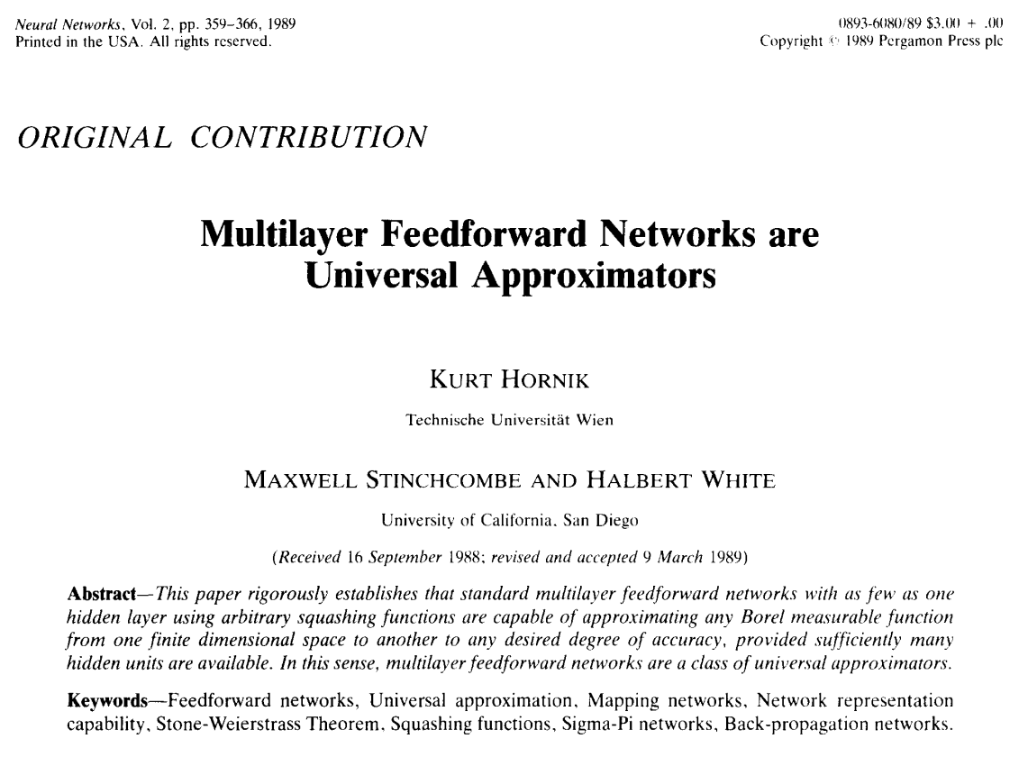
ANNs are Universal Approximators
15
Neural
Networks

Slide 16
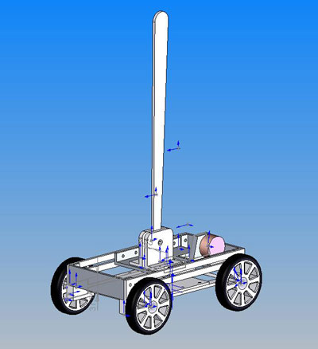
Why are ANNs Useful?
16
Neural
Networks
ANNs allow us to build systems that exhibit complex behaviour without having to analyse, model, and then explicitly code, the system.
This is because an ANN can ‘learn’ to model a complex system from training data.
Suppose you are asked to build a system that controls a turtle – a device with a computer controlled wheel at each corner – that balances a broom.
This is the inverted pendulum problem. This is well understood and there are good mathematical models.
How does one write a conventional program to maintain pendulum balance?

Slide 17

Neural Network Control of Inverted Pendulum
17
Neural
Networks
With a neural network it is possible to learn the ‘logic’ – the mathematical model – for balancing an inverted pendulum without having to analyse/understand the actual model.
To train the neural network, the inverted pendulum is controlled by a human using a joystick.
The neural network will have two inputs:
A camera that shows the behaviour of the pendulum.
The inputs to the pendulum from the human-controlled joystick.
The neural network then learns to balance the pendulum by observing the joystick outputs of the human in response to pendulum behaviour (camera).

Slide 18

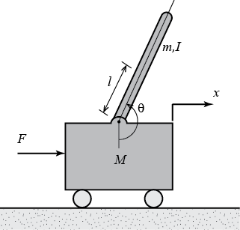
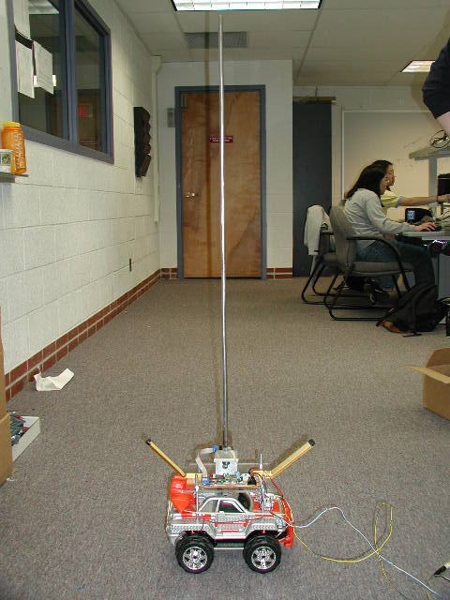



Neural Network Control of Inverted Pendulum
18
Neural
Networks
Neural
Network

Slide 19
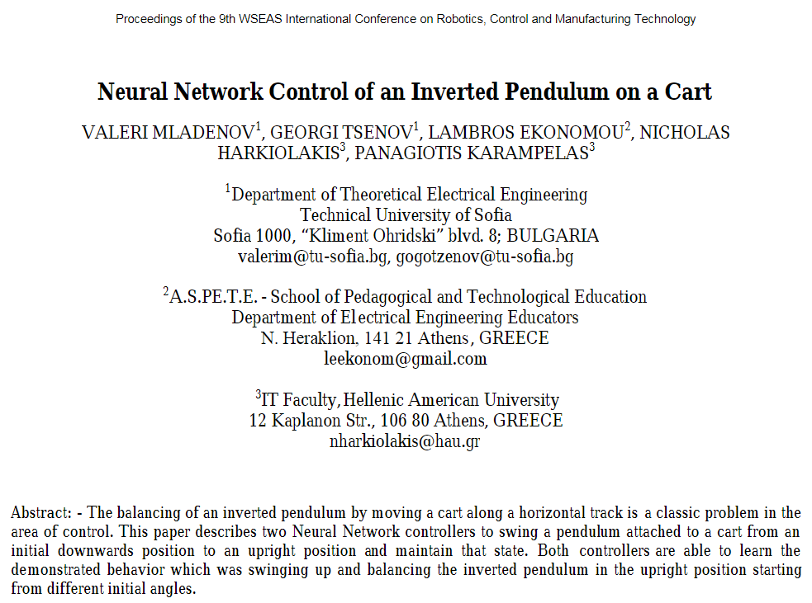
19
Neural
Networks

Slide 20
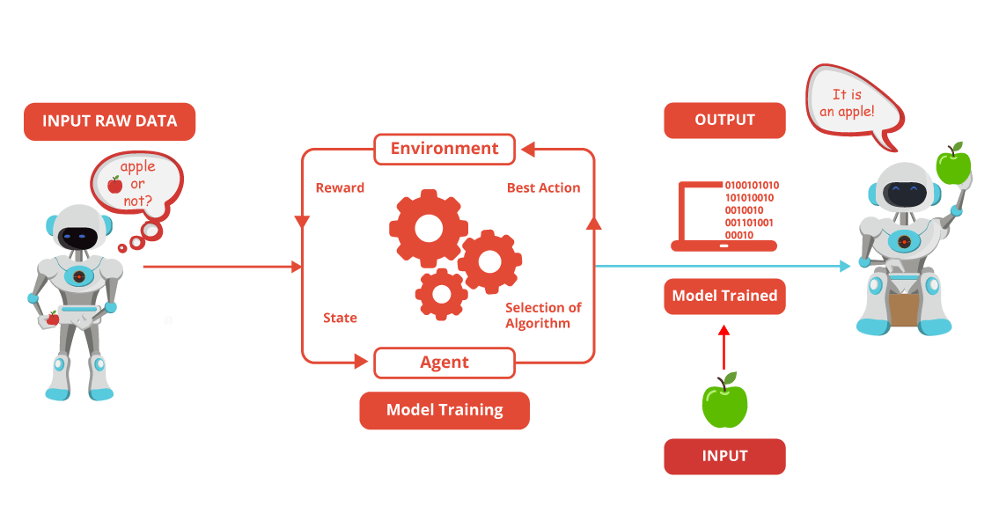
Other Neural Network Applications
20
Neural
Networks
Text Classification and Categorization (NLP)
Part-of-Speech Tagging (NLP)
Motor Control
Handwriting Recognition
Stock Market Prediction
Weather Prediction
TSP Approximation
Speech Recognition
Human Face Recognition
Signature Recognition
Remember! – You need good training data!

Slide 21





Neural Networks in BI
21
Neural
Networks
The so-called Big Four accountancy and consulting firms are investing heavily in AI.
ANNs are used extensively in predictive analytics.
They can find patterns and trends in large datasets and today are considered an important tool in data warehousing and data analytics.

Slide 22

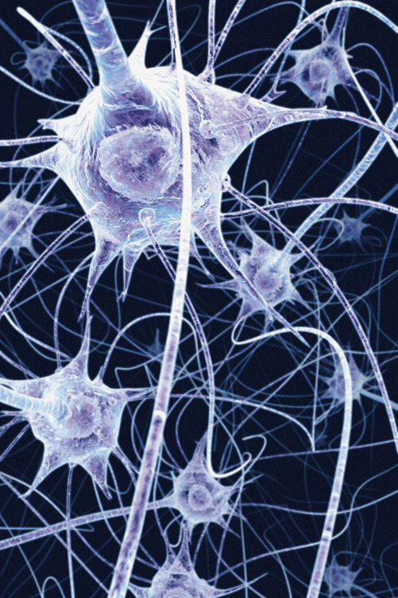
Artificial Neural Networks (ANNs)
22
Neural
Networks
ANNs are very loosely based on biological brains which are made up of billions of interconnected, special cells called neurons.

Slide 23
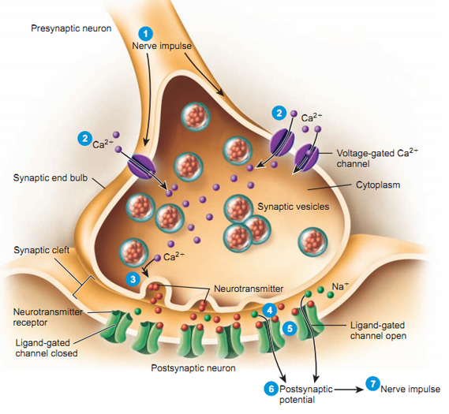
Artificial Neural Networks (ANNs)
23
Neural
Networks
Biological brains are many orders of magnitude more complex than the best ANNs.
Biological neurons are far more complex than artificial neurons.
That is why we say that artificial neural networks are loosely based on biological brains.
Neurons are also much more complex than a transistor.
By comparison, the human brain has around 100 x 10⁹ neurons.

Slide 24
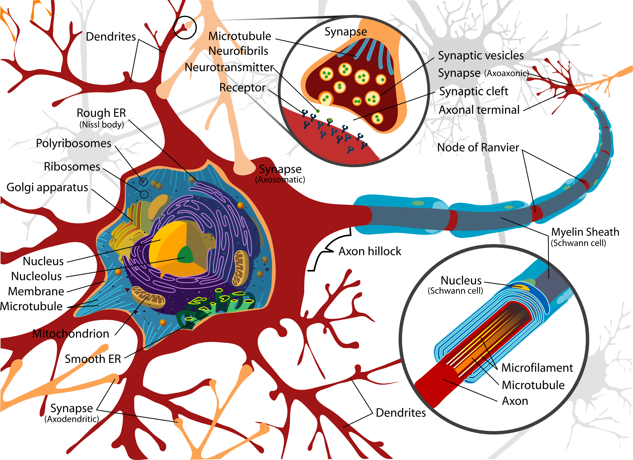
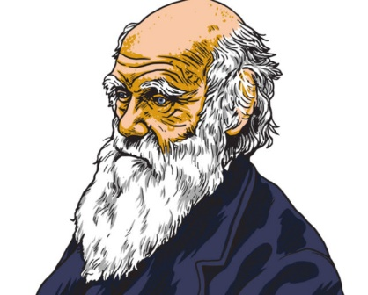
Some Stats about Human Brains
24
Neural
Networks
Approximately 100 Billion neurons.
Each neuron connected to 10K other neurons.
1,000 trillion connections.
1 trillion bits per second processing.
1,000 terabytes memory capacity.
Biological brains were designed by evolution and there is still much we still have to learn about these incredible organs.
A single human brain is arguably more complex than all the computers in the world!
Charles
Darwin

Slide 25
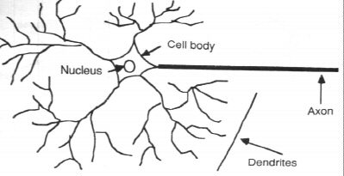
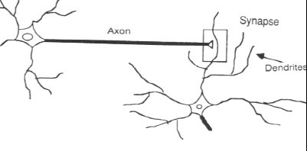
How Human Brains Learn
25
Neural
Networks
In the human brain, a typical neuron collects signals from others through a host of fine structures called dendrites.
The neuron sends out spikes of electrical activity through a long, thin strand known as an axon, which splits into thousands of branches.
At the end of each branch, a structure called a synapse converts the activity from the axon into electrical effects that inhibit or excite activity in the connected neurons.

Slide 26
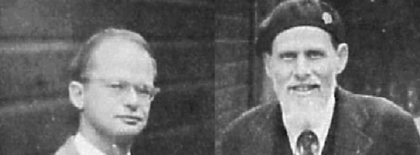
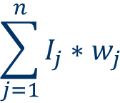
An Artificial Neuron
26
Neural
Networks
First proposed by Warren McCulloch and Walter Pitts in 1943.
It was the first model of an artificial neuron albeit much simpler than a biological neuron.
It could perform some computation but was not, on its own, Turing Powerful.
The first version accepted only binary inputs and outputs.
An artificial neuron is a device with many inputs and one output. The inputs and the output are real numbers.
Associated with every input I_{j} is a weight w_{j}. Weights are also real numbers – positive or negative.
The neuron has two processing units. The summation (or summing) unit and the transfer (activation) function.
Input 1
w₁
Input 2
w₂
Input 3
w₃
f
Input 4
w₄
$$\sum_{j=1}^{n}{I_{j}∗w_{j}}$$
out
…
w_{j}
Input j
…
w_{n}
Input n

Slide 27
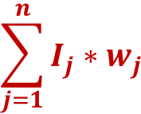
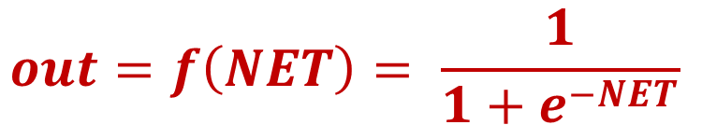
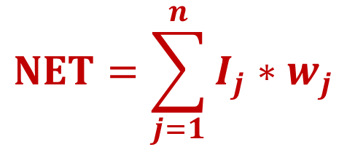
27
Neural
Networks
An Artificial Neuron
Input I₁
w₁
Associated with every input I_{j} is a weight w_{j}. Weights are also real numbers.
The neuron has two processing units. The summation (or summing) unit and the transfer (activation) function.
The summation unit multiplies each input by its connection weight and then adds the products. This produces the value NET.
The output of the neuron is f(NET) where f() is the transfer function.
A popular transfer (activation) function is sigmoid (below).
Input I₂
w₂
Input I₃
w₃
$$\sum_{j=1}^{n}{I_{j}∗w_{j}}$$
f
Input I₄
w₄
out
…
w_{j}
Input I_{j}
…
NET
w_{n}
Input I_{n}
$$NET=\sum_{j=1}^{n}{I_{j}∗w_{j}}$$
$$out=f\left(NET\right)= \frac{1}{1+e^{−NET}}$$

Slide 28
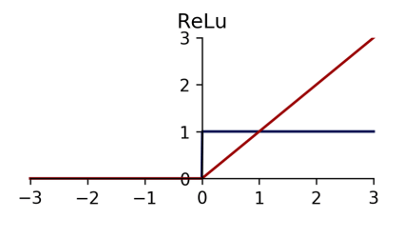
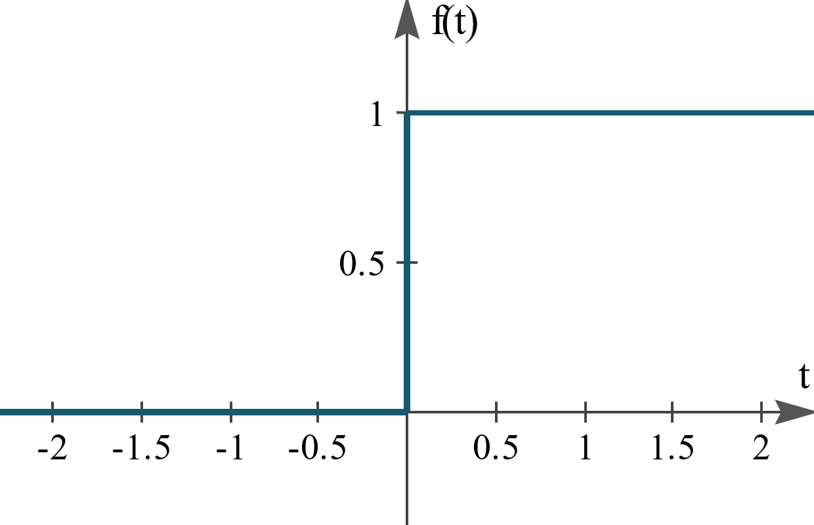
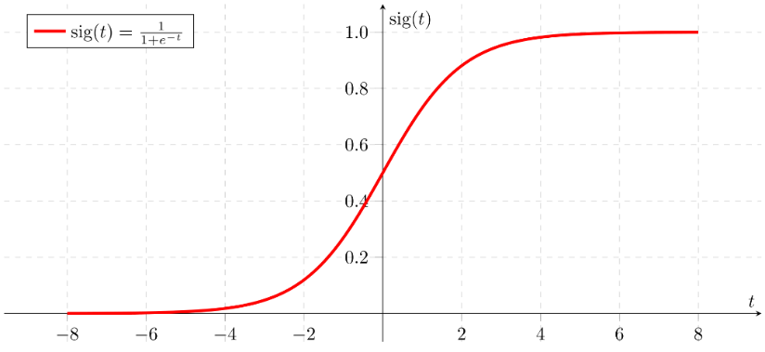
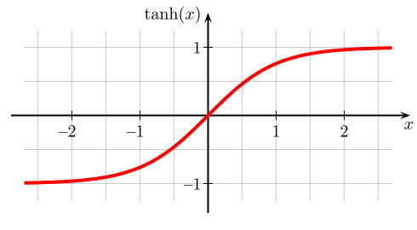
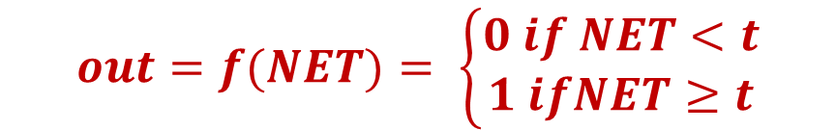
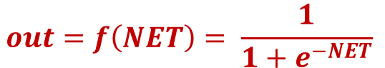

28
Neural
Networks
Transfer (Activation) Functions
Input I₁
w₁
There are many transfer functions in use.
The most popular is sigmoid.
The first artificial neurons used a linear step function.
Other popular transfer functions are TanH and ReLu.
ReLu is now replacing sigmoid.
Input I₂
w₂
Input I₃
w₃
f
$$\sum_{j=1}^{n}{I_{j}∗w_{j}}$$
Input I₄
w₄
out
…
w_{j}
Input I_{j}
NET
…
w_{n}
Input I_{n}
$$out=f(NET)= \left\{\begin{aligned}0 if NET<t \\ 1 ifNET≥t\end{aligned}\right.$$
$$out=f\left(NET\right)= \frac{1}{1+e^{−NET}}$$
Linear Step
function with t = 0
Sigmoid

Slide 29
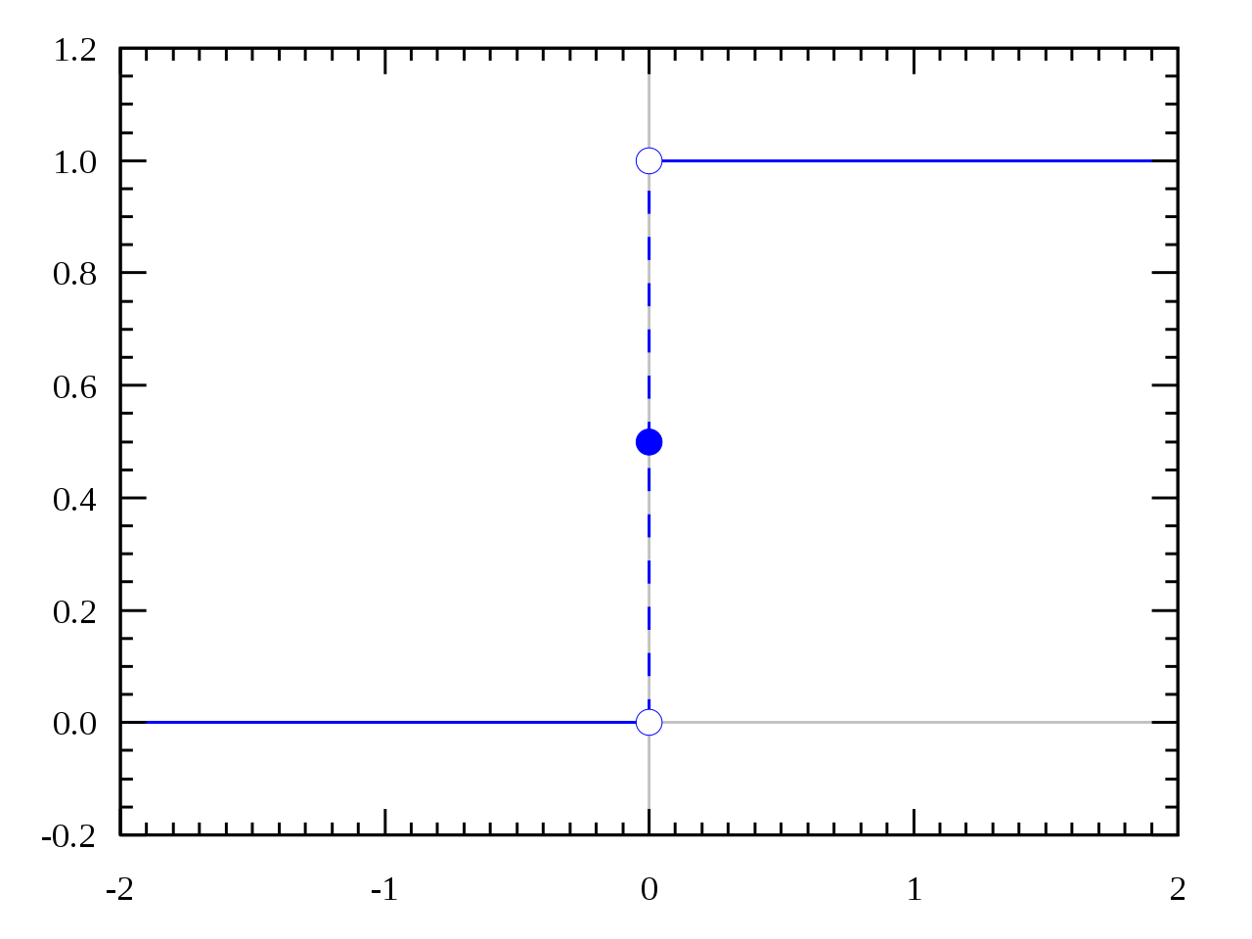
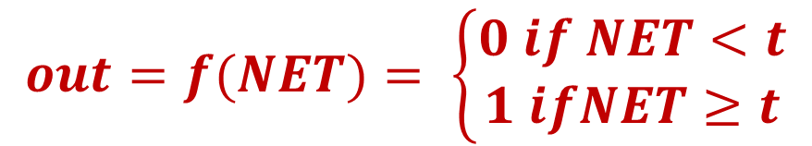
29
Neural
Networks
Linear Step Function
This type of function is often called the Heaviside function.
All input values less than t are mapped to 0 and all input values greater than or equal to t are mapped to 1.
Sometimes called a threshold function. The value t is the threshold.
This is a very simple discontinuous, piecewise linear, function.
Many early artificial neurons used this function.
It was later found to have shortcomings and was replaced with the non-linear functions.
The sigmoid function which is continuous and differentiable everywhere will be used in our examples.
t
$$out=f(NET)= \left\{\begin{aligned}0 if NET<t \\ 1 ifNET≥t\end{aligned}\right.$$

Slide 30
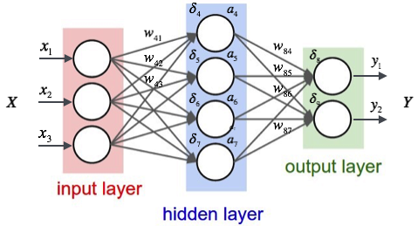
Artificial Neural Networks (ANNs)
30
Neural
Networks
In a typical ANN, the neurons are organized in layers.
The first layer is the input layer followed by 1 or more hidden layers and then the output layer.
Data (and computation) flow is from the inputs X_{i} to the outputs Y_{i}.
Each neuron in every layer, except the output layer, is connected to every neuron in the next layer.
Associated with each connection is a weight. A weight is real number.
Each neuron in every layer, except the input layer, accepts the outputs of the neurons in the previous layer as inputs.
Such networks are called feed forward.

Slide 31
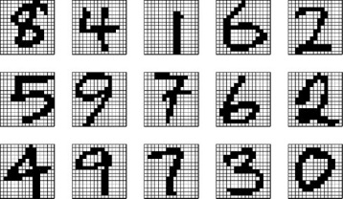
Pattern Recognition
31
Neural
Networks
An important application of neural networks is pattern recognition. Pattern recognition can be implemented by using a feed-forward neural network that has been trained accordingly.
During training, the network is trained to associate target outputs with input patterns.
During training, the network identifies the input pattern and tries to output the associated target output pattern.
The power of neural networks comes to life when a pattern that has no output associated with it, is given as an input.
In this case, the network gives the output that corresponds to a taught input pattern that is least different from the given pattern.
Good labelled training data must be available.
The quality of the training data is critical.
Note this is an example of supervised learning since the learning algorithm is given the input patterns and also the target value (label) for each output.
8
4
1

Slide 32

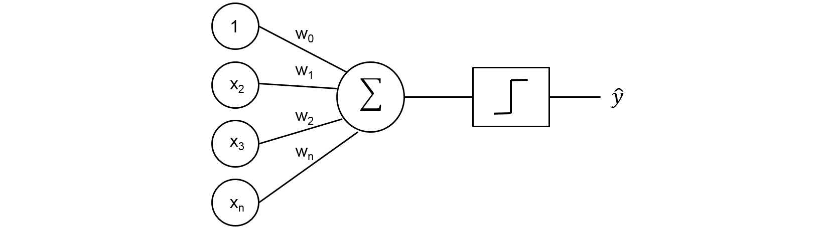
The Perceptron
32
Neural
Networks
American psychologist Frank Rosenblatt, who made important contributions in the field of Artificial Intelligence, proposed a simple two-layer feed-forward neural network he called the Perceptron.
This network has just two layers – an input layer and an output layer.
Each neuron used a simple linear step function with t = 0.5.
A perceptron could compute certain (simple) types of functions.
The perceptron was an example of computation by non-von Neumann architectures.
This caused a lot of excitement in scientific circles and in the press.

Slide 33
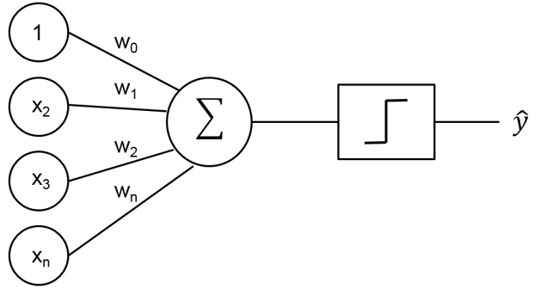
The Perceptron
33
Neural
Networks
The Perceptron can actually compute simple functions such as Boolean AND and Boolean OR.
One must only find a set of weights that allows the perceptron to produce, given some binary input, the correct output.
There is usually more than one set of weights that will work.
This is true for all neural networks – training involves finding a set of weights that enables the network to produce the correct output.
For simple networks, such as the one below right, you can find a set of weights visually by inspection.
This network has only 2 weights – w₁ and w₂ .
The set of weights is usually not unique.
∑
f
AND gate
OR gate
w₁
0 0
0
0 0
0
∑
f
0 1
0
0 1
1
1 0
0
1 0
1
w₂
1 1
1
1 1
1
∑
f

Slide 34

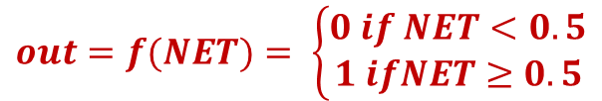
A Perceptron to Compute Boolean AND
34
Neural
Networks
Consider a simple Perceptron that computes the Boolean AND function.
The transfer function is the linear step function with t = 0.5
We must find a set of weights that enable the Perceptron to give the correct output for all 4 possible inputs.
Input connections have a weight of 1 (not shown).
For the simple example we can find the weights by inspection or eyeballing.
Let the weights be w₁ = 0.3 and w₂ = 0.4
Consider the input 0, 1
The output will be 0 as shown below.
Try the other inputs as well to confirm that the chosen weights work.
$$out=f(NET)= \left\{\begin{aligned}0 if NET<0.5 \\ 1 ifNET≥0.5\end{aligned}\right.$$
0
∑
f
0
0.3
AND gate
∑
f
0
Since f(0.4) = 0
0 0
0
0 1
0
0.4
1 0
0
∑
f
NET =
(0 * 0.3) = 0 +
(1 * 0.4) = 0.4
1 1
1
1
1

Slide 35
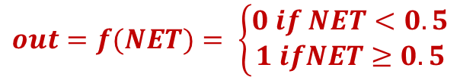
A Perceptron to Compute Boolean OR
35
Neural
Networks
Consider a simple Perceptron that computes the Boolean OR function.
Again, the transfer function is the linear step function with t = 0.5 and the input connections have a weight of 1 (not shown).
Also for this simple example, we can trivially find (choose) the weights by inspection.
Let the weights be w₁ = 0.5 and w₂ = 0.6
Consider the input 0, 1
The output will be 1 as shown below.
Try the other inputs as well to confirm that the chosen weights give the expected outputs.
$$out=f(NET)= \left\{\begin{aligned}0 if NET<0.5 \\ 1 ifNET≥0.5\end{aligned}\right.$$
0
∑
f
0
0.5
∑
f
1 since f(0.6) = 1
OR gate
0.6
0 0
0
∑
f
NET =
(0 * 0.5) = 0 +
(1 * 0.6) = 0.6
0 1
1
1
1
1 0
1
1 1
1

Slide 36

Some Notes on the Input Neurons
36
Neural
Networks
Note that the input neurons act as identity functions (the output is exactly the input). This is because:
The input connection weight is always 1 (shown). Anything multiplied by 1 remains the same. The neuron will always output the input – whether this is a 0 or a 1.
It is common to represent the input neurons as squares (with a italics script I to denote identity) as shown below.
We shall, henceforth, be using this convention – all input neurons are identity neurons.
I
1.0
0
$$out=f(NET)= \left\{\begin{aligned}0 if NET<0.5 \\ 1 ifNET≥0.5\end{aligned}\right.$$
0
∑
f
w₁
w₁
∑
f
∑
f
Output
w₂
w₂
1.0
I
1
∑
f
1

Slide 37
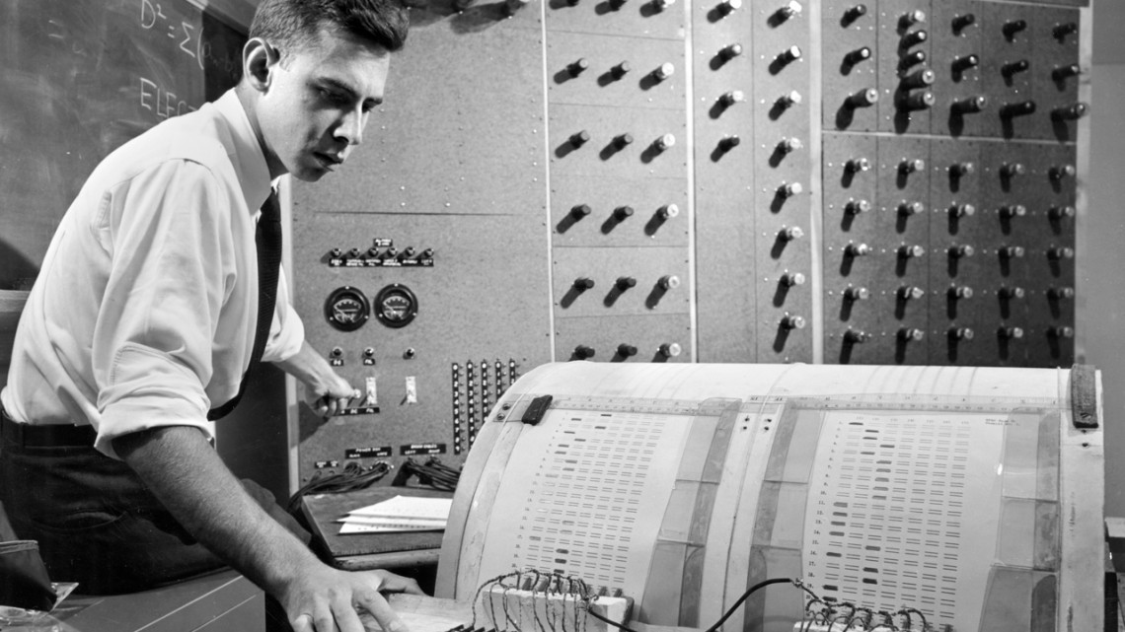
Reaction to the Perceptron
37
Neural
Networks
The introduction of the Perceptron caused a sensation not only in scientific circles and the press but also amongst science fiction writers.
It was, in many ways, the very first neural network.
However, it was a very simple device and had some obvious limitations.
It only had two layers – the input layer and the output layer.
There was no simple way, in general, to find the correct set of weights for complex networks.
The weights had to be hard-coded.
It also had computational limitations that we will discuss soon.
Frank Rosenblatt and an IBM 704 Computer at Cornel

Slide 38

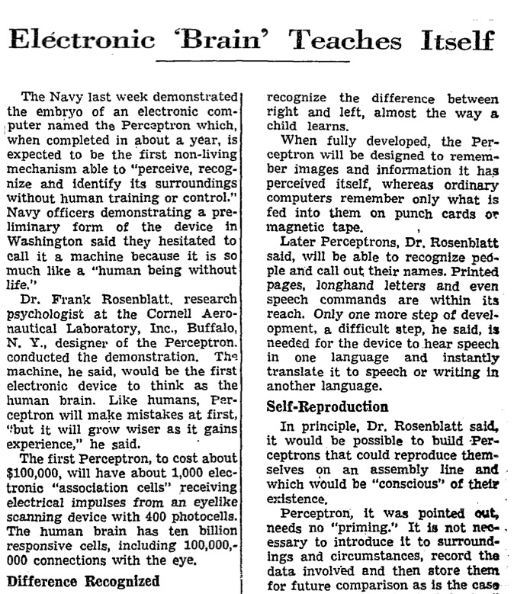
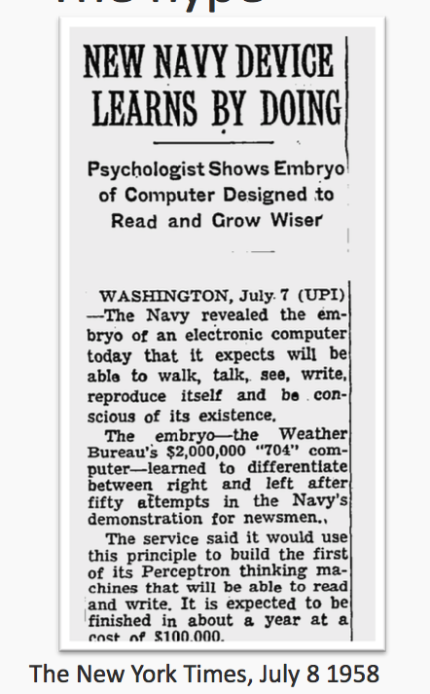
The Press goes Crazy
38
Neural
Networks

Slide 39



Reaction to the Perceptron
39
Neural
Networks
Frank Rosenblatt published a book - Principles of Neurodynamics: Perceptrons and the Theory of Brain Mechanisms - published by Spartan Books in 1962. He later used the book as a textbook in his University courses.
Rosenblatt received international recognition for the Perceptron. The New York Times billed it as a revolution, with the headline “New Navy Device Learns By Doing”.
Neural computing started to attract a lot of research funding for academic, commercial, and even military applications.
Rosenblatt had a childhood friend, Marvin Minsky. Both boys had gone to the same high school in The Bronx, New York City. They were fiercely competitive.
Marvin Minsky would later become a famous AI Guru at MIT (Massachusetts Institute of Technology).

Slide 40


The Book by Minsky and Papert
40
Neural
Networks
Everything changed when Marvin Minsky and Seymour Papert published the book ‘Perceptrons: An introduction to Computational Geometry’ in 1969.
The book contained a number of mathematical proofs that acknowledged the perceptron’s strength while also pointing out major limitations.
The book was criticized as being overly pessimistic and this was responsible for a change in direction of research in AI and contributing to the first AI Winter of the 1980s.
Frank Rosenblatt died in July 1971 on his 43rd birthday, in a boating accident. Minsky was reportedly heartbroken.
An expanded edition of the Perceptrons book was published after Rosenblatt’s death which addressed the criticisms made.

Slide 41



The Limitations of the Perceptron
41
Neural
Networks
The main limitation of the perceptron was that it could only compute functions that were (geometrically) linearly separable.
This means that, in the input space of a given Boolean function, one can separate the inputs that return True (1) from those that return False (0) using a straight line (hyperplane).
In the diagrams below suppose that we are learning a Boolean function - one that returns True (1) or False (0) – and that the red dots are those inputs that return False and the blue dots are the inputs that return True.
We embed the inputs in Euclidean space (in this case the Cartesian Plane) and determine whether we can separate the two classes (True and False) using a line (or hyperplane).
Linearly Separable
Linearly Inseparable

Slide 42

Are Boolean AND and Boolean OR Linearly Separable?
42
Neural
Networks
Let us first consider the Boolean AND function. Is it linearly separable?
What about Boolean OR? Is it also linearly separable?
Clearly, if the inputs are embedded in a Cartesian Plane and the True inputs are coloured Blue and the False inputs coloured Red then it is easy to find a line to separate the two classes.
Both Boolean AND and OR are linearly separable functions and can be computed by a Perceptron.
Now what about Boolean XOR (Exclusive OR)?
Geometric Representation
1
Boolean AND
Boolean OR
0 0
0
1
0 0
0
0 1
0
0 1
1
1 0
0
1 0
1
1 1
1
1 1
1
0
1
0
1
Linearly Separable?
Linearly Separable?

Slide 43

Is Exclusive OR (XOR) Linearly Separable?
43
Neural
Networks
Let us first consider the Boolean XOR function. Is it linearly separable?
Clearly, if the inputs are embedded in a Cartesian Plane, as below, and the True inputs coloured Blue and the False inputs coloured Red then it is impossible to find a straight line (or hyperplane) to separate the two classes.
Boolean XOR is not linearly separable. It is linearly inseparable and therefore cannot be computed by a perceptron.
Unfortunately (for the Perceptron) many real World problems are linear inseparable.
Back then, a solution for this problem was not immediately obvious.
1
Boolean XOR
0 0
0
0 1
1
1 0
1
1 1
0
0
1
Linearly Separable?

Slide 44
The Fallout from Minsky and Papert’s Book
44
Neural
Networks
When the Perceptrons book was published many researchers turned their focus to symbolic AI techniques rather than Vector Space (Numeric) AI such as Neural Networks.
Many people felt that the book was unnecessarily pessimistic and was meant to discredit Rosenblatt’s work.
To their credit, Minsky and Papert did publish a second edition where most of the limitations were addressed.
There is still controversy about the true intentions of the actors in this saga.
It turns out that that if:
The perceptron has three layers – input, hidden, and output, and;
The transfer function is non-linear, continuous and differentiable everywhere. Then the perceptron is Turing powerful and could compute, in theory, any function.
These neural networks are today called MLPs – Multi-Layer Perceptrons.
This re-ignited interest in neural networks.

Slide 45


45
Neural
Networks
Neural
Networks

Slide 46


Minsky and Papert’s Book – Second Edition
46
Neural
Networks
It was now clear that a multi-layer perceptron (MLP) with at least one hidden layer and a non-linear transfer function (such as sigmoid) would make the network Turing Powerful.
In theory, one can find an MLP to compute any computable function.
One problem was determining the topology of the MLP – number of layers, number of neurons in each layer, and some other parameters.
The main show-stopper, however, was how to find a set of weights that were consistent with the training examples – i.e. a set of weights that would correctly classify the training examples.
For simple networks, such as the Boolean AND and OR functions, this could be done visually by inspection (or eyeballing).
For larger, more complex, networks with many layers this would not be possible.
Note that the input layer neurons are identity neurons.

Slide 47





Important Note
47
Neural
Networks
A multi-layer perceptron (MLP) is just one type of artificial neural network (ANN).
There are many types of neural networks. In this module we will consider only the MLP since it is one of the simplest, and most popular, neural networks.
We will also cover the algorithm (Error Back Propagation) that is used to train MLPs.
WISARD
Support
Vector
Machines

Slide 48




Classification vs Regression
48
Neural
Networks
Supervised learning algorithms fall under two main categories – Classification and Regression.
Both use labelled data to train (fit) a model.
The most significant difference between regression and classification is that while regression tries to predict a continuous quantity, classification predicts discrete class labels.
An example of regression is predicting tomorrow’s price of a certain stock from historical data.
An example of classification is recognizing images of dogs from cats or classifying emails as Spam or non-Spam (Ham).
The output from a regression model is usually a numeric quantity (integer or real number) while the output of a classification model is a class label (dog or cat, Spam or Ham). This is called a categorical variable.

Slide 49
Classification Problems and Algorithms
49
Neural
Networks
Classification Problems
Learning Boolean functions.
Classifying Images (Oranges Vs Bananas).
Detecting Tumors in Medical Imaging.
Sentiment Analysis
OCR
Spam Detection
Fake News Detection
POS Tagging
Taxonomy
Credit Card Fraud Detection
Customer Churn
Face Recognition
Classification is about assigning a class label to the input data.
Classification Algorithms
Neural Networks
Decision Trees
Random Forests
Naïve Bayes
Gradient Boosting
LSTM
K-Nearest Neighbours
Logistic Regression
Support Vector Machines
XGBoost
Note that many machine learning algorithms can be configured for either classification or regression.

Slide 50
Regression Problems and Algorithms
50
Neural
Networks
Regression Problems
Predicting Stock Markets Prices
Predicting Property Values
Credit Score Rating
Crop Yield
Predicting Likelihood of Customer Churn
Temperature Prediction
Regression is about predicting a continuous or discrete value for the input data.
Regression Algorithms
Neural Networks
Random Forests
LSTM
Logistic Regression
Linear Regression
Recurrent Neural Networks
Support Vector Regression
Lasso Regression
Note that many machine learning algorithms can be configured for either classification or regression.

Slide 51
























MLP Training vs Testing
51
Neural
Networks
Training Images
Testing Images
cat
cat
cat
Cat
cat
cat
cat
cat
cat
cat
dog
dog
dog
dog
dog
dog
dog
dog
dog
dog
In supervised learning we need labelled datasets. In the above example we have 10 labelled images of cats and 10 labelled images of dogs.
We usually (randomly) divide the dataset into training and testing examples.
For instance, we might want to use 70% of the data for training and the remaining 30% for testing.
The training data is used by the selected learning algorithm – this is called ‘fitting a model’.
In many Python machine learning packages there is a fit() method. In essence, you are ‘fitting’ the training data to the model.
The testing data is then is classified by the trained model to determine classification or prediction performance. There are various metrics for the evaluation of classification and regression algorithms.

Slide 52






Training a Multi-layer Perceptron
52
Neural
Networks
Training an MLP is essentially the task for finding a set of weights that will allow the MLP to classify the training examples correctly.
Suppose we want the MLP to learn to distinguish between images of cats and dogs.
The training set consists of 50 labelled images of cats and 50 labelled images of dogs.
The images are represented as vectors (there are many ways that this can be done – process called feature selection).
The MLP is then trained to output 0,1 if the input image is a cat and 1,0 in the input image is a dog.
The weights are initially randomly initialized to a real number between -1 and 1.
How does one find a set of weights (real numbers) to correctly classify all the training examples?
Trying to find the weights by inspection is not feasible since there might be many hundreds or thousands of weights.
(0.1, 2.3, 9.1, 1.2, 1.0, 0.7)
cat
cat
cat
dog
dog
dog

Slide 53

Training a Multi-layer Perceptron
53
Neural
Networks
The goal of any learning algorithm is to find a function that best maps a set of inputs to their correct output.
Training a multi-layer perceptron is the task of finding the appropriate internal representations (weights) to allow it to compute any arbitrary mapping of input to output.
This can be accomplished by using the Error Back Propagation Algorithm (Backprop) to find a set of weights that we need.
The main feature of backpropagation is its iterative and efficient method for calculating the weight updates to improve the network until it is able to perform the task for which it is being trained.
Various researchers had worked on this problem since the 1960s.
In 1986, through the work of David E. Rumelhart, Geoffrey E. Hinton, Ronald J. Williams, and James McClelland, error backpropagation gained recognition and became the standard way of training neural networks.

Slide 54

How is a Multi-layer Perceptron Trained?
54
Neural
Networks
Training a multi-layer perceptron is the SOLE task of finding the appropriate internal representations (weights) to allow it to compute any arbitrary mapping of input to output.
Before moving on to the details of how Error Backpropagation works let us first look at the basic ideas behind neural network training.
We will illustrate how an multi-layer perceptron is trained using a conceptual, visual, example.
We can then move on to a detailed explanation of the Error Back Propagation algorithm.
Some important notes and reminders:
A ‘toy’ example will be used to demonstrate how an MLP is trained.
Remember that training involves ONLY finding a set of weights that will classify the training examples correctly. What this means will become clear as we go along.
Training is accomplished using supervised learning. This means that the training examples are labelled. Each example will be labelled with the class it belongs to.
The topology of the MLP is fixed before training. The topology includes the number of layers, the number of neurons in each layer, the type of transfer function, and other parameters.
The only thing that changes during training is the set of weights.

Slide 55

Multi-layer Perceptron Training A Visualization
55
Neural
Networks

Slide 56


Multi-layer Perceptron Training A Visualization
56
Neural
Networks
Error surface for 2 weights.

Slide 57


Neural Network Classifier with One Hot Encoded Output
57
Neural
Networks

Slide 58
Multi-layer Perceptron Training – A Toy Example
58
Neural
Networks
Suppose (again) that we want to train a multi-layer perceptron to correctly classify images of cats and dogs.
This ‘toy’ example is ‘cool’ since it serves to demonstrate the power of supervised learning.
If you are not convinced then try to write a conventional algorithm to classify images of cats and dogs.
The Training Set
To keep things simple suppose we have 3 (labelled) images of cats and 3 (labelled) images of dogs.
Each image is represented by a feature vector of 6 real numbers (how this is done is not important – neural networks work with vectors for input and output). Since the output also has to be a vector then let (0,1) denote a cat and (1,0) denote a dog.
(0.1, 2.3, 9.1, 1.2, 1.0, 0.7),(1,0)
cat
cat
cat
dog
dog
dog

Slide 59
Multi-layer Perceptron Training – A Toy Example
59
Neural
Networks
All training examples, and their labels, are represented by vectors.
Each image is represented by a 6-dimensional feature vector and the label represented by a 2-dimensional vector where (0,1) denotes a pussy cat and (1,0) denotes a doggie.
The training set is shuffled (randomized) before training starts.
Each training example (pair of vectors) is called a ‘fact’.
Training Examples
(2.1, 0.5, 6.1, 1.2, 6.0, 5.1),(0,1) cat
(0.9, 2.4, 6.3, 0.9, 6.2, 4.8),(0,1) cat
(2.8, 1.5, 6.9, 1.9, 6.7, 5.8),(0,1) cat
(0.1, 2.3, 9.1, 1.2, 1.0, 0.8),(1,0) dog
(0.5, 2.5, 9.3, 1.1, 1.2, 0.6),(1,0) dog
(0.7, 2.7, 9.8, 1.7, 1.6, 0.7),(1,0) dog
Training Examples (randomized)
(0.5, 2.5, 9.3, 1.1, 1.2, 0.6),(1,0) dog
(0.1, 2.3, 9.1, 1.2, 1.0, 0.8),(1,0) dog
(0.9, 2.4, 6.3, 0.9, 6.2, 4.8),(0,1) cat
(2.1, 0.5, 6.1, 1.2, 6.0, 5.1),(0,1) cat
(2.8, 1.5, 6.9, 1.9, 6.7, 5.8),(0,1) cat
(0.7, 2.7, 9.8, 1.7, 1.6, 0.7),(1,0) dog
fact
cat
cat
cat
dog
dog
dog

Slide 60



60
An Artificial Neuron – Reminder!
Neural
Networks
Input I₁
w₁
The neuron has two processing units. The summation (or summing) unit and the transfer (activation) function.
The summation unit multiplies each input by its connection weight and then adds the products. This produces the value NET.
The output of the neuron is f(NET) where f() is the transfer function.
A popular transfer (activation) function is sigmoid (shown below).
Input I₂
w₂
Input I₃
w₃
f
Input I₄
w₄
$$\sum_{j=0}^{n}{I_{j}∗w_{j}}$$
out
…
w_{j}
Input I_{j}
…
w_{n}
NET
Input I_{n}
$$NET=\sum_{j=0}^{n}{I_{j}∗w_{j}}$$
$$out=f\left(NET\right)= \frac{1}{1+e^{−NET}}$$

Slide 61


Multi-Layer Perceptron - Topology
61
Neural
Networks
The neural network topology is the architecture of the ANN. The means:
The number of layers and the number of neurons in each layer.
The connections between the neurons and their direction.
The transfer (activation) function used for the neurons.
In our MLP:
There are 3 layers – input (i), hidden (j), and output (k)
The number of neurons in each layer is:
input – 6, hidden - 5, and output – 2.
The input layer neurons are identity neurons – denoted by a square. They just copy the input to the output.
The transfer function for the hidden and output neurons is the sigmoid function.
This is a feed-forward network so the direction of the connections (weights) is always forward – from input to output.
$$f(x)=\frac{1}{1+e^{−x}}$$
∑│f
∑│f
cat
0
1
dog
1
0
∑│f
∑│f
∑│f
∑│f
∑│f
i
input
j
hidden
k
output

Slide 62

One Hot Encoding
62
Neural
Networks
Suppose you want a neural network (of any type) to classify unseen items into 3 classes (for example, images of oranges, bananas, and apples).
With one hot encoding you assign, for each class, a ‘1’ to a specific output neuron with all other output neurons assigned a ‘0’.
For n classes you need n output neurons.
For our example you assign ‘100’ to the class Orange, ‘010’ to Banana, and ‘001’ to Apple.
One-Hot Encoding is very often used to label the training examples.
We are using one hot encoding for our toy example.
Orange
1
0
0
Banana
0
1
0
Apple
0
0
1

Slide 63

Alternative to One Hot Encoding
63
Neural
Networks
One hot encoding is the most popular output representation (target labelling).
One hot encoding is sometimes called ‘distributed representation’.
The alternative is to have a single output neuron with a specific output value per class. This is shown below.
In our case the single output neuron will output -1 if the input is an Orange, 0 for a Banana, and 1 for an Apple.
This is often called ‘scaled representation’.
There are various (mathematical) reasons why One Hot Encoding is preferred
Orange -1
Banana 0
Apple 1

Slide 64
Multi-Layer Perceptron – Pre-Training
64
Neural
Networks
We want to train the MLP so that if we input an image of a cat (as a vector) the network will output (0,1) for cat and if we input an image of a dog then the output will be (1,0).
Before training we must do the following:
Randomize (shuffle) the training examples.
Initialize all the weights with random values between -1 and 1.
Set the Learning Rate η (Greek letter eta) This is a real number between 0 and 1 usually set to 0.2. Used to determine how much of the neuron error is used to modify the weights.
Set the Error Threshold μ (Greek letter mu) This is a real number between 0 and 1 usually set to 0.2. Used to determine how much of the neuron error ‘leeway’ is given to the output layer neurons.
Another parameter is the maximum number of epochs. More about this later.
∑│f
∑│f
cat
0
1
dog
1
0
∑│f
∑│f
∑│f
∑│f
Weights
5 X 2 = 10
∑│f
Weights
6 X 5 = 30
i
input
j
hidden
k
output

Slide 65


Multi-Layer Perceptron Training
65
Neural
Networks
0.5 | 2.5 | 9.3 | 1.1 | 1.2 | 0.6
1 | 0
Fact 1
i
input
Error Threshold μ = 0.2 (Greek letter mu)
j
hidden
0.5
k
output
∑│f
2.5
Training Examples (randomized)
(0.5, 2.5, 9.3, 1.1, 1.2, 0.6),(1,0) dog
(0.1, 2.3, 9.1, 1.2, 1.0, 0.8),(1,0) dog
(0.9, 2.4, 6.3, 0.9, 6.2, 4.8),(0,1) cat
(2.1, 0.5, 6.1, 1.2, 6.0, 5.1),(0,1) cat
(2.8, 1.5, 6.9, 1.9, 6.7, 5.8),(0,1) cat
(0.7, 2.7, 9.8, 1.7, 1.6, 0.7),(1,0) dog
Output
Target
Error
9.3
∑│f
0.821
1
0.179
1.1
0.341
0
-0.341
1.2
1 epoch
0.6
If at least one of the output neurons has an absolute error larger then the error threshold then the fact is called a ‘bad’ fact.
Error
Back Propagation
Algorithm
Perform Feed Forward on the input (vector) to produce the output (vector)
Important!

Slide 66
Multi-Layer Perceptron Training
66
Neural
Networks
Epoch 1 – Fact 1
i
input
j
hidden
100%
k
output
Training Examples (Facts)
(0.5, 2.5, 9.3, 1.1, 1.2, 0.6),(1,0)
(0.1, 2.3, 9.1, 1.2, 1.0, 0.8),(1,0)
(0.9, 2.4, 6.3, 0.9, 6.2, 4.8),(0,1)
(2.1, 0.5, 6.1, 1.2, 6.0, 5.1),(0,1)
(2.8, 1.5, 6.9, 1.9, 6.7, 5.8),(0,1)
(0.7, 2.7, 9.8, 1.7, 1.6, 0.7),(1,0)
Bad
Bad Facts
Epochs
Error
Back Propagation
Algorithm
Perform Feed Forward to produce the network output.
As per previous slide.

Slide 67
Multi-Layer Perceptron Training
67
Neural
Networks
Epoch 1 – Fact 2
i
input
j
hidden
100%
k
output
Training Examples (Facts)
(0.5, 2.5, 9.3, 1.1, 1.2, 0.6),(1,0)
(0.1, 2.3, 9.1, 1.2, 1.0, 0.8),(1,0)
(0.9, 2.4, 6.3, 0.9, 6.2, 4.8),(0,1)
(2.1, 0.5, 6.1, 1.2, 6.0, 5.1),(0,1)
(2.8, 1.5, 6.9, 1.9, 6.7, 5.8),(0,1)
(0.7, 2.7, 9.8, 1.7, 1.6, 0.7),(1,0)
Bad
Bad Facts
Bad
Epochs
Error
Back Propagation
Algorithm
Perform Feed Forward to produce the network output.
As per previous slide.

Slide 68
Multi-Layer Perceptron Training
68
Neural
Networks
Epoch 1 – Fact 3
i
input
j
hidden
100%
k
output
Training Examples (Facts)
(0.5, 2.5, 9.3, 1.1, 1.2, 0.6),(1,0)
(0.1, 2.3, 9.1, 1.2, 1.0, 0.8),(1,0)
(0.9, 2.4, 6.3, 0.9, 6.2, 4.8),(0,1)
(2.1, 0.5, 6.1, 1.2, 6.0, 5.1),(0,1)
(2.8, 1.5, 6.9, 1.9, 6.7, 5.8),(0,1)
(0.7, 2.7, 9.8, 1.7, 1.6, 0.7),(1,0)
Bad
Bad Facts
Bad
Bad
Epochs
Error
Back Propagation
Algorithm
Perform Feed Forward to produce the network output.
As per previous slide.

Slide 69
Multi-Layer Perceptron Training
69
Neural
Networks
Epoch 1 – Fact 4
i
input
j
hidden
100%
k
output
Training Examples (Facts)
(0.5, 2.5, 9.3, 1.1, 1.2, 0.6),(1,0)
(0.1, 2.3, 9.1, 1.2, 1.0, 0.8),(1,0)
(0.9, 2.4, 6.3, 0.9, 6.2, 4.8),(0,1)
(2.1, 0.5, 6.1, 1.2, 6.0, 5.1),(0,1)
(2.8, 1.5, 6.9, 1.9, 6.7, 5.8),(0,1)
(0.7, 2.7, 9.8, 1.7, 1.6, 0.7),(1,0)
Bad
Bad Facts
Bad
Bad
Bad
Epochs
Error
Back Propagation
Algorithm
Perform Feed Forward to produce the network output.
As per previous slide.

Slide 70
Multi-Layer Perceptron Training
70
Neural
Networks
Epoch 1 – Fact 5
i
input
j
hidden
100%
k
output
Training Examples (Facts)
(0.5, 2.5, 9.3, 1.1, 1.2, 0.6),(1,0)
(0.1, 2.3, 9.1, 1.2, 1.0, 0.8),(1,0)
(0.9, 2.4, 6.3, 0.9, 6.2, 4.8),(0,1)
(2.1, 0.5, 6.1, 1.2, 6.0, 5.1),(0,1)
(2.8, 1.5, 6.9, 1.9, 6.7, 5.8),(0,1)
(0.7, 2.7, 9.8, 1.7, 1.6, 0.7),(1,0)
Bad
Bad Facts
Bad
Bad
Bad
Bad
Epochs
Error
Back Propagation
Algorithm
Perform Feed Forward to produce the network output.
As per previous slide.

Slide 71
Multi-Layer Perceptron Training
71
Neural
Networks
Epoch 1 – Fact 6
i
input
6 Bad – 0 Good Facts
100% Bad Facts
j
hidden
100%
k
output
Training Examples (Facts)
(0.5, 2.5, 9.3, 1.1, 1.2, 0.6),(1,0)
(0.1, 2.3, 9.1, 1.2, 1.0, 0.8),(1,0)
(0.9, 2.4, 6.3, 0.9, 6.2, 4.8),(0,1)
(2.1, 0.5, 6.1, 1.2, 6.0, 5.1),(0,1)
(2.8, 1.5, 6.9, 1.9, 6.7, 5.8),(0,1)
(0.7, 2.7, 9.8, 1.7, 1.6, 0.7),(1,0)
Bad
Bad Facts
Bad
Bad
Bad
Bad
Bad
Epochs
Error
Back Propagation
Algorithm
Perform Feed Forward to produce the network output.
As per previous slide.

Slide 72
Multi-Layer Perceptron Training
72
Neural
Networks
Epoch 2
i
input
5 Bad – 1 Good Facts
83% Bad Facts
j
hidden
100%
k
output
Training Examples (Facts)
(0.5, 2.5, 9.3, 1.1, 1.2, 0.6),(1,0)
(0.1, 2.3, 9.1, 1.2, 1.0, 0.8),(1,0)
(0.9, 2.4, 6.3, 0.9, 6.2, 4.8),(0,1)
(2.1, 0.5, 6.1, 1.2, 6.0, 5.1),(0,1)
(2.8, 1.5, 6.9, 1.9, 6.7, 5.8),(0,1)
(0.7, 2.7, 9.8, 1.7, 1.6, 0.7),(1,0)
Good
Bad Facts
Bad
Bad
Bad
Bad
Bad
Epochs
Do not perform
Back Propagation!
Perform Feed Forward to produce the network output.
As per previous slide.

Slide 73
Multi-Layer Perceptron Training
73
Neural
Networks
Epoch 3
i
input
4 Bad – 2 Good Facts
66.7% Bad Facts
j
hidden
100%
k
output
Training Examples (Facts)
(0.5, 2.5, 9.3, 1.1, 1.2, 0.6),(1,0)
(0.1, 2.3, 9.1, 1.2, 1.0, 0.8),(1,0)
(0.9, 2.4, 6.3, 0.9, 6.2, 4.8),(0,1)
(2.1, 0.5, 6.1, 1.2, 6.0, 5.1),(0,1)
(2.8, 1.5, 6.9, 1.9, 6.7, 5.8),(0,1)
(0.7, 2.7, 9.8, 1.7, 1.6, 0.7),(1,0)
Good
Bad Facts
Bad
Bad
Good
Bad
Bad
Epochs

Slide 74
Multi-Layer Perceptron Training
74
Neural
Networks
Epoch 4
i
input
5 Bad – 1 Good Facts
83% Bad Facts
j
hidden
100%
k
output
Training Examples (Facts)
(0.5, 2.5, 9.3, 1.1, 1.2, 0.6),(1,0)
(0.1, 2.3, 9.1, 1.2, 1.0, 0.8),(1,0)
(0.9, 2.4, 6.3, 0.9, 6.2, 4.8),(0,1)
(2.1, 0.5, 6.1, 1.2, 6.0, 5.1),(0,1)
(2.8, 1.5, 6.9, 1.9, 6.7, 5.8),(0,1)
(0.7, 2.7, 9.8, 1.7, 1.6, 0.7),(1,0)
Bad
Bad Facts
Bad
Bad
Good
Bad
Bad
Epochs

Slide 75
Multi-Layer Perceptron Training
75
Neural
Networks
Epoch 271
i
input
0 Bad – 6 Good Facts
0% Bad Facts
j
hidden
100%
k
output
Training Examples (Facts)
(0.5, 2.5, 9.3, 1.1, 1.2, 0.6),(1,0)
(0.1, 2.3, 9.1, 1.2, 1.0, 0.8),(1,0)
(0.9, 2.4, 6.3, 0.9, 6.2, 4.8),(0,1)
(2.1, 0.5, 6.1, 1.2, 6.0, 5.1),(0,1)
(2.8, 1.5, 6.9, 1.9, 6.7, 5.8),(0,1)
(0.7, 2.7, 9.8, 1.7, 1.6, 0.7),(1,0)
Good
Many
epochs…
Good
Bad Facts
Good
Good
Good
Good
Epochs
Training only stops when we have one full epoch with only good facts.
Each training example (fact) produces an output error less than the error threshold (for all output neurons.)
We say that the network has ‘converged’ and stop training.
The weights are stored on disk.

Slide 76
MLP Training - Pseudocode
76
Neural
Networks
Decide and Fix Network Topology # of layers, types of neurons, etc.
Randomize all weights (-1 to +1)
Shuffle (randomize) the training examples Do this once before training starts
Set Eta = 0.2, Mu = 0.2 Learning Rate & Error Threshold
Repeat Start training
Start Epoch
Set GoodFacts, BadFacts = 0
Get Training example (input vector, target vector)
Feed input vector to input layer & Feed Forward
Compare output to Target and Compute error
If at least one output neuron has error > Error Threshold then
Pass the Error/s to Error Back Propagation Algorithm
This will Modify the weights to reduce the error.
BadFacts++ Increment BadFacts
Else
Do nothing
GoodFacts++ Increment GoodFacts
End If
End Epoch
Until BadFacts = 0 One full epoch with no bad facts
Save the weights This is a good idea!

Slide 77
Some notes about MLP Training
77
Neural
Networks
We have discussed how an MLP is trained without explaining how the Error Back Propagation algorithm modifies the weights when training encounters a bad fact. This comes soon.
The required number of epochs varies. Sometimes the network is trained for a fixed number of epochs (say 100 or 1000). Some people prefer to let the network train until it ‘converges’.
Note & Remember!
The network ‘converges’ when it performs one epoch with only good facts. This means that the network went through each training example and the error for each output neuron was less than the error threshold μ .
In this case, back propagation was not called to modify the weights. The weights remained unchanged for this epoch.
You do not have to reshuffle (randomize) the order of the training examples for each epoch.
When the network converges the weights must be stored. These weights correctly classify each training example.
The weights are then used to classify unseen examples (not in the training set) to determine if the network can ‘generalize’. If you do not save the weights you will have to re-train if your switch off the computer.
To ‘generalize’ in machine learning means learning from a fixed number of training examples in order to be able to classify correctly any unseen (testing) examples.
Humans are very good at generalization.
The set of weights obtained by convergence is not unique. If training is performed again (with the same training set) the final weights (after convergence) will very probably be different.

Slide 78
More notes about MLP Training
78
Neural
Networks
Note & Remember!
It is useful to experiment with different values of the Learning Rate η (Greek letter eta) and the Error Threshold μ (Greek letter mu).
It is important to avoid a situation called over-fitting. This is when the MLP only learns the training data and cannot correctly classify unseen examples. This happens when the neural network is over-trained (too many epochs or a very small error threshold).
When the trained network is then used to classify the testing set, it is normal to perform classifier evaluation. In other words, you must determine how well the trained neural network classified the unseen testing examples.
Testing examples are called ‘unseen’ because they were not used for training.
There are various evaluation metrics for classifiers. This topic will be discussed separately.
Neural network training is an NP-Hard problem (to solve optimally). Avrim L. Blum & Ronald L. Rivest, 1992.

Slide 79

ReLU vs Sigmoid
79
Neural
Networks
Various activation functions are used in artificial neurons.
The step function is not used very much anymore except in academic settings.
Up to a few years ago Sigmoid was still king.

Slide 80

ReLU vs Sigmoid
80
Neural
Networks
Sigmoid has some disadvantages:
It is computationally expensive to compute.
Input values above 4 or below -4 are mapped to 1 or 0 respectively.
You therefore lose information about the magnitude of the input.
Both 5 are 500 mapped to 1.
ReLU (Rectified Linear Unit) has largely replaced Sigmoid in many ANN applications (except in the output layer).
Relu, and its derivative, are much faster to compute.
Addresses (to some extent) the vanishing gradient problem.
In practice, networks with Relu tend to show better convergence performance than sigmoid [Krizhevsky et al].
Tends to blow up activation since there is no mechanism to constrain the output of the neuron.
Dying Relu problem - if too many inputs get below zero then most of the units(neurons) in network with Relu will simply output zero, in other words, die and thereby prohibiting learning. This can be overcome, to some extent, by using Leaky-Relu instead.
Sigmoid
ReLU

Slide 81


Neuron Bias
81
Neural
Networks
Bias works like the intercept added in a linear equation.
It is an additional parameter in an ANN which is used to adjust the output along with the weighted sum of the inputs to the neuron.
Thus, Bias is a constant which helps the model in a way that it can fit best for the given data.
Bias allows you to shift the activation function by adding a constant (i.e. the given bias) to the input.
output = f(sum (weights * inputs))+ bias

Slide 82

Neuron Bias
82

Slide 83

Artificial Neural Networks – Part 1
83
Neural
Networks

